Slide 1

Quantum Secure Socket Layer (QSSL)
Presenting: Matan Czuckermann Raz Tibi Supervisor: Ronen Zilber
1

Slide 2

CRYPTOLOGY TODAY
Secures digital communications and data.
Includes cryptography (codes) and cryptanalysis (code-breaking).
Essential for banking, e-commerce, and secure messaging.
Post-quantum cryptography protects against future quantum threats.
2
Notes:
Cryptology plays a critical role in protecting the data we exchange in an increasingly connected world. It includes both cryptography, the art of creating secure codes, and cryptanalysis, which is breaking those codes. Today, it's the foundation of technologies like online banking, e-commerce, and secure messaging, ensuring that even over vulnerable networks, our data is safe. However, with the advent of quantum computing, we need to evolve cryptology. That's where post-quantum cryptography comes in—designed to withstand the immense power of quantum computers, ensuring our security in the future.

Slide 3
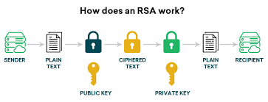
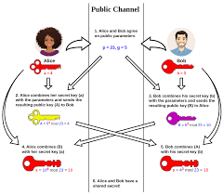
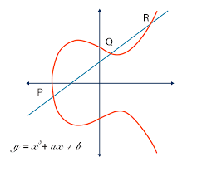
CURRENT CRYPTOGRAPHIC METHODS
RSA (Rivest-Shamir-Adleman):
Public-key cryptosystem
Based on factoring large numbers
Used for encryption and digital signatures
Diffie-Hellman:
Key exchange protocol
Based on discrete logarithm problem
Allows secure key sharing over public channels
ECC (Elliptic Curve Cryptography):
Based on algebraic structure of elliptic curves
Offers smaller key sizes for equivalent security
3
Notes:
In todays cryptography tha main Three algorithms encryption are: RSA which based on the problem of Factoring a large number which is the multiplicand of two prime numbers. It is an asymmetric algorithm. Which means that for decryption and encryption we uses different keys.
DH which is a key exchange protocol based on the discrete logarithm problem where the two sides swipe keys between them and than compute together a common key. And EC which is also relies on the discrete logarithm problem.

Slide 4
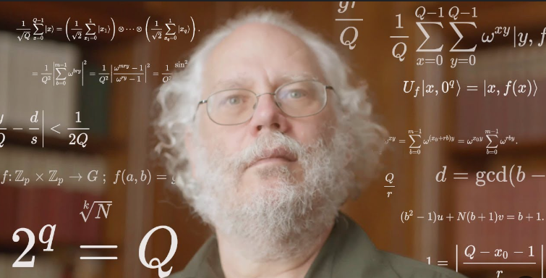
SHOR’s ALGORITHM
In 1994 Peter Shor an American mathematician, invented a quantum algorithm for finding prime factors of an integer.
It is one of the few known quantum algorithms with compelling potential applications and strong evidence of super polynomial speedup compared to best known classical (non-quantum) algorithms.
Shor's algorithm could be used to break public-key cryptography schemes
Peter Shor
4
Notes:
The RSA scheme
The Finite Field Diffie-Hellman key exchange
The Elliptic Curve Diffie-Hellman key exchange peter shor invented the Shors algorithm the main problematic algorithm that basically, given enough powerful quantum computer can crack the previous algorithm.

Slide 5


SHOR’s ALGORITHM
Let N be odd and not a prime power, Find non-trivial factors of N:
Pick a random number 2 < a < N
Compute K = gcd(a,N)
If K != 1
K is a non trivial factor of N Other factor $N/k$
DONE
Otherwise, a and N are co primes -> $a^{r} ≡1 mod N$
N divides $a^{r}−1$, (Euler’s Theory) - > $N|(a^{\frac{r}{2}}−1)(a^{\frac{r}{2}}+1)$
Compute g = gcd(N, $a^{\frac{r}{2}}+1$)
if g != 1
G is a non trivial factor of N
Other factor $N/g$
DONE
Otherwise, go back to step 1
Solves Prime decomposition of big numbers in O((logN)^3) time and O(logN) space
See https://scottaaronson.blog/?p=208
5
Notes:
Prime power – number that divides by exactly one prime number 3^2 = 9, 2^4 = 16, ….
Gcd = greatest common divider
Other wise – k has inverse in integers modulo N (coprimes), for smallest r possible
We don’t take the a^r/2-1 because that would implement that r/2 is the inverse of a where we said its r already
Shors algorithm relies on the principle of quantum computing which given the possibility run simultaneously many option. We pick a random number and tries to compute the order of a. Than if a^r – 1 dividing N so also the other representation.

Slide 6

The problem
Shor's algorithm can efficiently factor large numbers - break RSA
Shor's algorithm can solve the discrete logarithm problem – break Diffie-Hellman
Shor's algorithm can solve Elliptic-Curve discrete logarithm problem – break ECC
All known public key cryptography schemes are vulnerable to Quantum attacks.
In the near future all those schemes will be useless and unprotected from malicious attacks.
Furthermore attackers can Harvest now and decrypt later when possible.
Traditional security protocols like TLS may become vulnerable.
WHAT TO DO?
6
Notes:
So the problem is that if in the future indeed a strong enough quantum computer will rise we all understand that if the current cryptographic algorithm are broken we are having a crisis that needs to be addressed. So it is better to prepare for the future as early as possible.

Slide 7
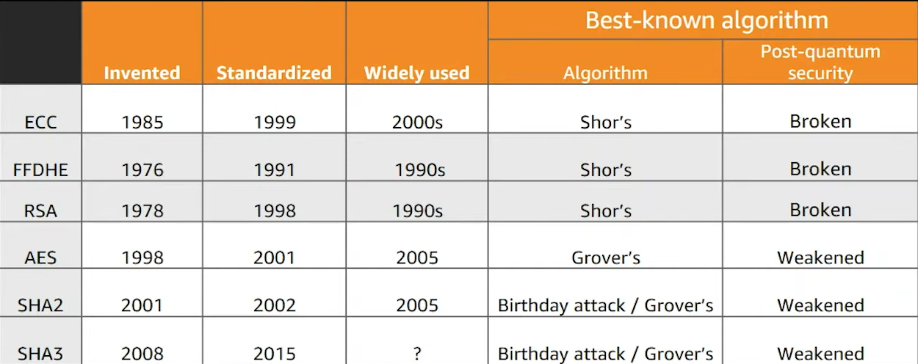
VULNERABILITY TO QUANTUM ATTACKS
7
Notes:
So to clear your ears, we can see that RSA and ECC broken entirely by shor’s algorithm which they both widly used today. In quantum copmuting there is also algorithms that weakend the known AES but not enough to be worried about it.

Slide 8
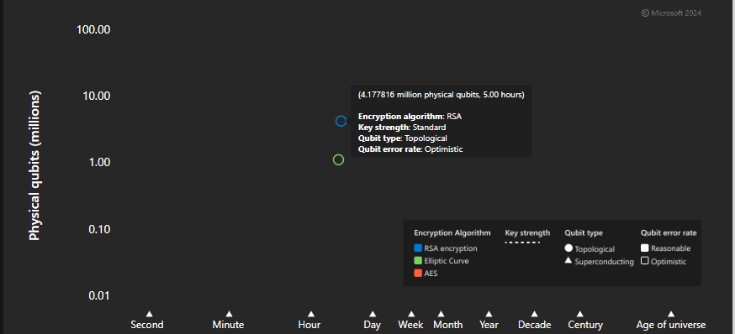
VULNERABILITY TO QUANTUM ATTACKS
8
Notes:
To give you some undersstaing when we say brake the encryption. Microsoft developed a simulator that tries to predict the time quantum computer will need to crack RSA and other algorihms, we can see that a quantum computer with 4.17 million Qubits a phrase that we will explain in a minute, will crack the known RSA in 5 hours.

Slide 9
The Solution - QSSL
QSSL – Quantum (Safe) Secure Sockets Layer
This research aims to explore the feasibility of enhancing the TLS protocol.
Integrating quantum-resistant algorithms for key generation and digital signatures.
NIST - National Institute of Standards and Technology, launched a Post-Quantum Cryptography Standardization Project in 2016 to handle that problem.
The goal is to create a more secure, quantum-resistant TLS protocol, ensuring future-proof protection for secure communications.
9
Notes:
TLS – transport layer security combining the known strength of RSA and ECCDSA together with KYBER and DILITHIUM both are quantum resistant algorithms to create a hybrid communication protocol that will be at least secured as the current protocols and most likely more secure, due to the reason that the quantum resistant algorithms are still at their development stage.

Slide 10
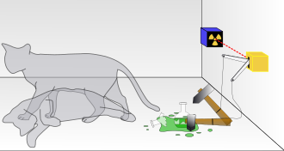
quantum physics ?
Superposition:
A quantum system can exist in multiple states simultaneously.
The system "collapses" into one state when observed or measured.
Example: An electron can be in different positions until it’s measured.
Schrödinger's Cat Thought Experiment:
A cat is placed in a box with a mechanism triggered by a quantum event.
Until observed, the cat is both alive and dead (superposition).
Opening the box "collapses" the superposition, revealing the cat’s actual state.
Highlights the paradoxes of quantum mechanics in large-scale objects.
10
Notes:
Important and main concept of quantum physics and the power of quantum computer is based on Superposition. Which means that a quantum system can exist in multiple states at once. And only when measured it collapses into one state. For example an electron can be in different positions until measured. The cat of Schrodinger illustrate it as a cat placed in a box with a mechanism triggered by a quantum event that will release poison. Until observed the cat is both dead and alive.

Slide 11
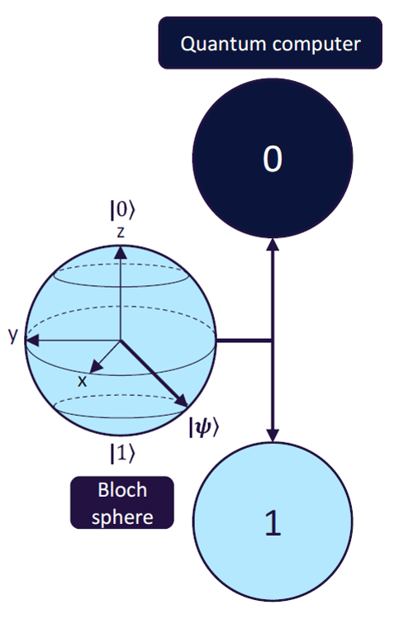
Principles of Quantum Computing
Quantum Bits (Qubits):
Basic unit of quantum information
Can exist in multiple states simultaneously (superposition)
Allows for exponential increase in computing power
Superposition:
Qubits can be in multiple states at once
Allows quantum computers to process multiple possibilities simultaneously
Enables exponential speedup for certain algorithms
Entanglement:
Quantum states of multiple particles are correlated
Allows for instant communication between entangled particles
Crucial for quantum algorithms and quantum cryptography
Quantum Algorithms:
Shor's Algorithm: Efficiently factors large numbers
Threaten current cryptographic systems
11
Notes:
The principles of quantum computer are: Qubits: this is the basic unit similar to bits in a classical computer. They can exist in a superposition The superposition in a quantum computer means that a Qubit can be in multiple state at once between 1 and 0 with some probability. Entangelment means that the quantum states of multiple particles are coreelated emanning that qubits can affect other qubits. This also crucial for quantum algoritrhms. And of course the famous shor’s algorithm that was mentioned.

Slide 12
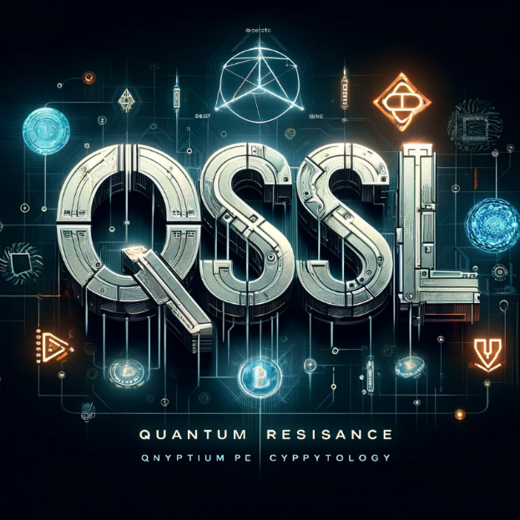
Importance of QSSL
Current Cryptography Secures:
Online communications (HTTPS, SSL/TLS)
E-commerce transactions and online banking
Government and military communications
Personal and corporate data privacy
Risks of Quantum Attacks
Mass data breaches and identity theft
Financial system instability
Compromise of national security
Loss of trust in digital infrastructure
12
Notes:
We can clearly understatn that all militry and government communication must stay secured and all the banking systems also, thus we can understatd the need for QSSL. Which hopefully withstand quantum attacks in the future.

Slide 13
Importance of QSSL
Why Quantum-Safe Cryptography is Crucial:
Protect against future quantum computer attacks
Ensure long-term security of sensitive data
Maintain integrity of digital economy and communications
Safeguard national and global security interests
Preserve privacy and trust in the digital age
13
Notes:
The benefit will be the obvious continuing the security of data there is today in the quantum era

Slide 14
Our IDEA
Quantum (safe) Secure Socket Layer (QSSL) :
Quantum resistant communication protocol
Based on TLS1.3 and NIST finalist algorithm
CRYSTALS - Kyber quantum key generation algorithm (KEM)
CRYSTALS - Dilithium quantum digital signature algorithm
14
Notes:
Transport layer security mention that The algorithms chosen, KYBER and DILITHIUM, are finalists in the NIST competition for quantum cryptography algorithms. Among a lot of other algorithm. Therefore we chose them as our algorithm for the implementation although the competition and the testing are ongoing still, so we keep to ourself the ability to respond to changes and even, maybe if necessary to change the algorithm that will be used. As mentioned combining the strength of RSA and ECDSA + the finalist of the NIST competition of secured quantum resistance algorithm KYBER for Key generation aand DILITHIUM for DS. Based on the current TLS 1.3 important to mention that the current algorithms are still Changning and under tests and they might change in the near future. Creating a secure Communication Protocol .

Slide 15
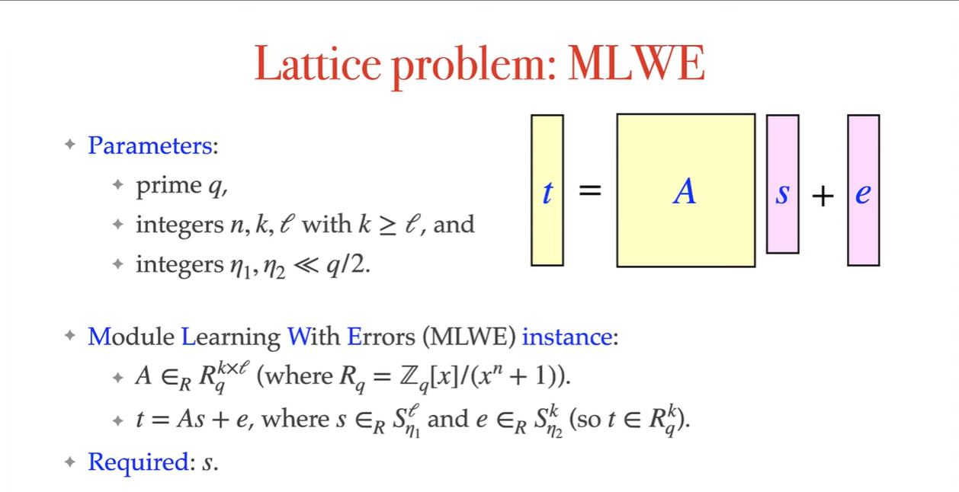
Learning with Errors
Learning with errors (LWE) - is a mathematical problem that is widely used to create secure encryption algorithms.
It is based on the idea of representing secret information as a set of equations with errors.
LWE is a way to hide the value of a secret by introducing noise to it
LWE is the foundation for quantum resistant algorithms
15
Notes:
M – modular aritmetics Small polynomials are polynomial where all its coefficients mods q are smaller or equal to some integer
A a random matrix whose entries are polynomial in the ring R_q t which obtained by small polynomials s and e than computing t as = As + e the problem here given A,t find s. No one knows an algorithm to compute s given A,t

Slide 16
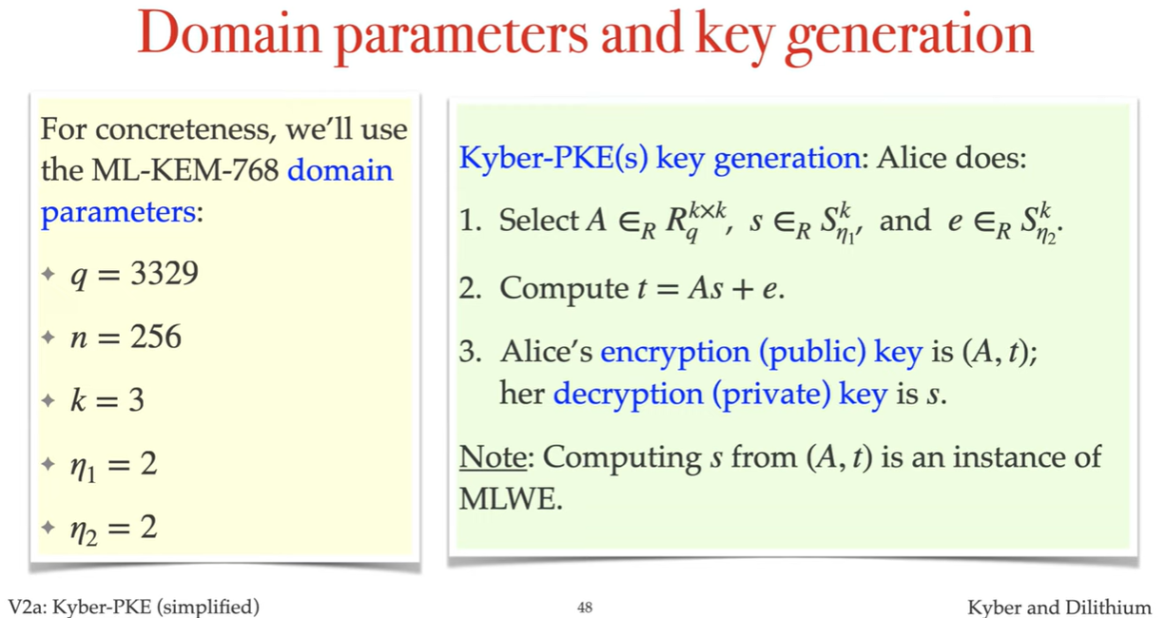
CRYSTALs PROJECT
CRYSTALS Project is a finalist in NIST Post-Quantum Cryptography Standardization Project. Both Kyber and Dilithium uses the same principles of LWE with lattices
16
Notes:
Both algorithms relies on the LWE problem with lattice where each one of them takes it to a little different firection: KYBER start with initializing A matrix of K over K of polynom mod q, and initialize S and E small polynomials with coefficients of size etha 1 and 2. than Alice computes t = As+e the public key generated is A,t here private key is s. Note that there is not an efficient known algorithm to compute S given A,t

Slide 17
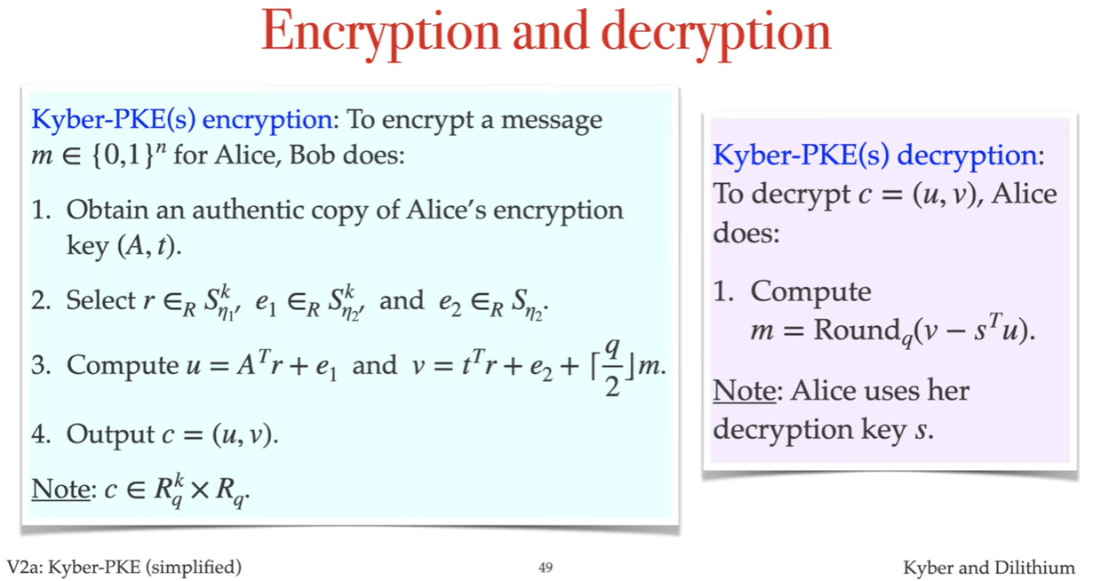
CRYSTALs kyber
17
Notes:
Upon receiving Alice public key from a reliable source, Bob can encrypt a message for alice. Using three small polynomials bob select he compute the following u and v. U = A^T r + e1 and V = t^T r + e2 + [q/2]m( replace all the one coefficient with q/2 and leave the zeros unchaned) the cyphertext is (u,v) To decrypt the cyphertext Alice uses here private key s with rounding function to cumpute m.

Slide 18
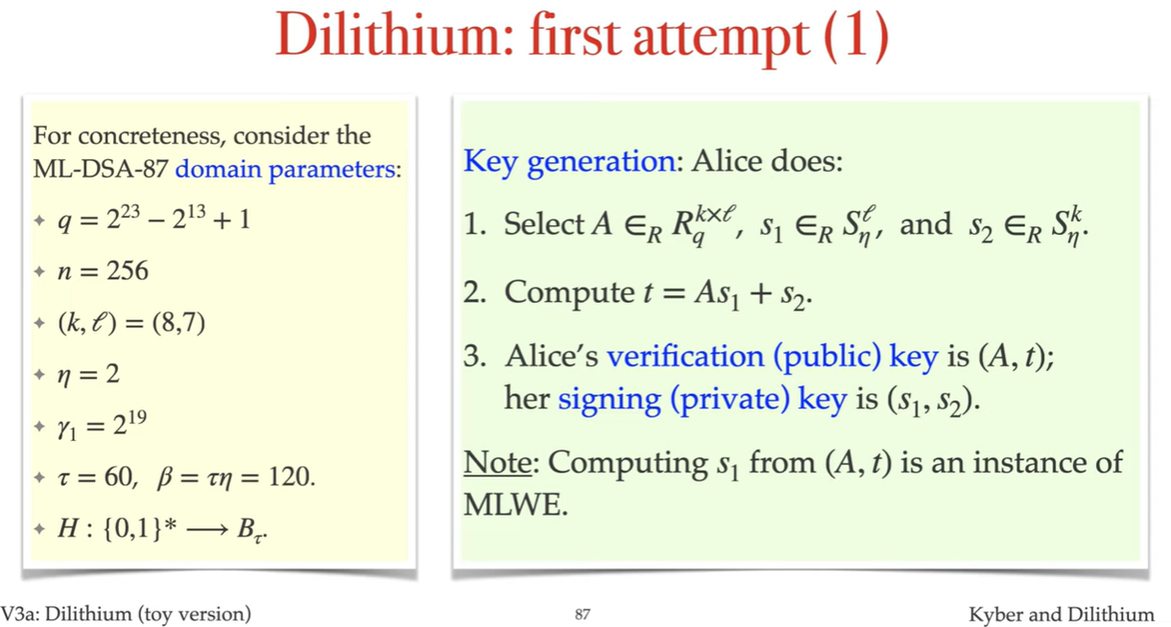
CRYSTALs Dilithium
18
Notes:
DILITHIUM is a quantum digital signature algorithm created to withstand a quantum attack, it uses similar problem as mentioned the LWE with lattice/ to create the key generation Alice needs to create a random polynomial matrix of k over l and to create another two small polynomial vectors S1 and S2. than she compute t = As1+s2. creating her public key A,t her private key will be s1,s2. note that as before, Given A,t there is not known way to now anything about s1 or s2.

Slide 19
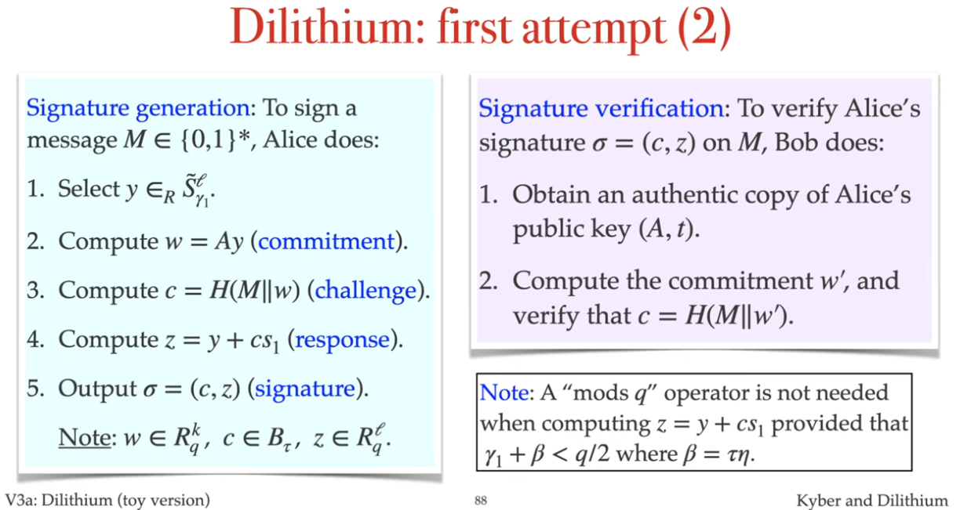
CRYSTALs Dilithium
19
Notes:
To sign a message m Alice does the following: Select a small polynomial vector y compute the commitment w = Ay than the challenge c by hashing the message concatenate to w. finaly compute z = y + cs1 the sineture is ( c,z) To verify Alice’s signature Bob, after receiving Alice’s public key Computes w the commitment and than using the same hash function he verifies the challenge c .

Slide 20
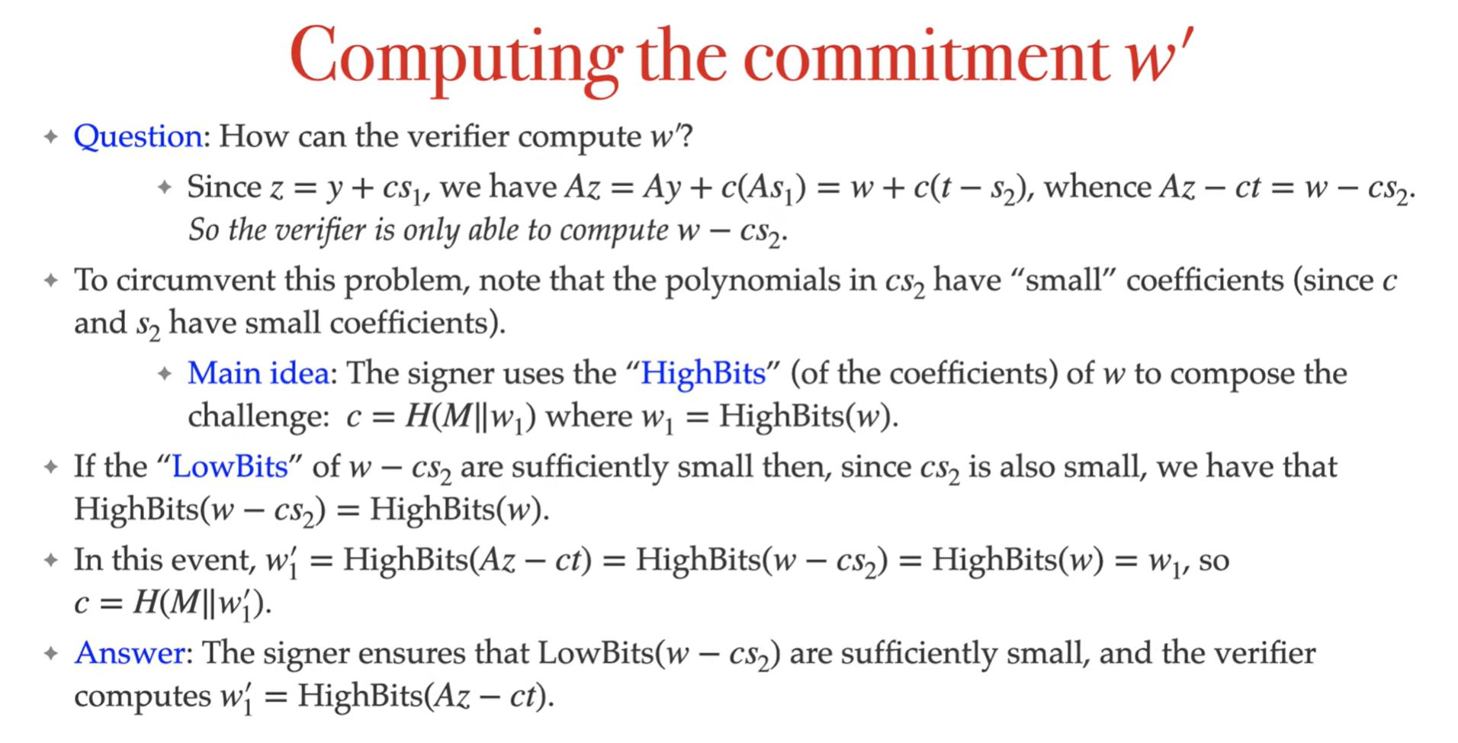
CRYSTALs Dilithium
20
Notes:
The question is how Bob compute the commitment? To compute the commitment in Dilithium, the signer focuses on signing only the high bits of the message. The high bits can be thought of as a mathematical function that adjusts or trims the coefficients of the polynomials(, reducing their size but keeping the key elements needed for verification.)

Slide 21
OUR Goal
RAFAEL has raised the need to defend from Quantum computers attack.
We are currently developing a communication protocol, built on TLS, that is protected from quantum attacks.
This protocol, if successfully developed, could be implemented across a wide range of projects, ensuring secure communication.
We want this protocol to be compatible with a wide range of systems and capable of running on both old and new firmware, without the need for hardware updates or replacements.
Currently, there is little to no implementation in this field, and most research efforts are still in their experimental stages.
21
Notes:
RAFAEL raised the need for defending for future quantum attacks. Therefor we will try to develop a secured quantum resistance protocol the if successfully developed could be implemented across a wide range of projects. We want this protocol to be compatible with a wide range of systems and capable of ruuning on old and new firmware without special changes. Currrently there is little to non implementation in this field and all of them are still experimental.

Slide 22
Our Problem: Ensuring Quantum Resistance
Lack of Large-Scale Quantum Computers:
We, and the rest of the world, do not yet have access to quantum computers capable of breaking current cryptographic protocols.
Testing the protocol’s quantum resistance remains theoretical for now.
Evolving Algorithms:
Quantum-resistant algorithms are still undergoing development and changes.
The fact that no algorithm can currently break them doesn't guarantee one won’t be discovered in the future.
Historical Precedent with RSA:
RSA encryption has not been proven unbreakable; it’s possible an unknown algorithm could crack it.
This uncertainty also applies to quantum-resistant algorithms.
22
Notes:
The main challenge, both for us and globally, is that there isn’t yet a quantum computer powerful enough to fully test these theories. As a result, we are unable to completely validate the algorithms’ resistance to quantum attacks. For now, testing remains largely theoretical and mathematical. Additionally, the field of quantum algorithms is evolving rapidly, making it possible that the currently chosen algorithms might undergo significant changes in the future."

Slide 23
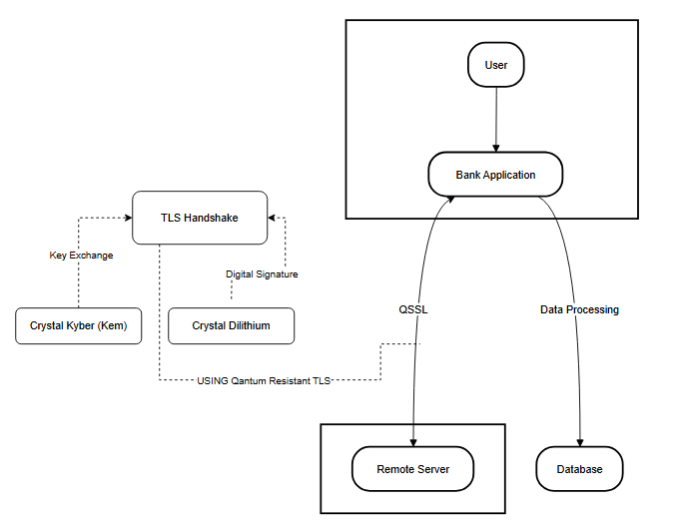
Our experiment
We plan to demonstrate our solution through a small application simulating bank access.
During this process, the user and the bank server will initiate a TLS handshake and employ hybrid key exchange to generate a quantum-resistant key.
Upon successfully completing the handshake, the user will gain access to their account.
23
Notes:
We plan to demonstrate our solution through a small application simulatin bank access. During the process the user will initiate a TLs handshake with the server and e,ploy hubrid key exchange to generate a quantum resistant key.

Slide 24
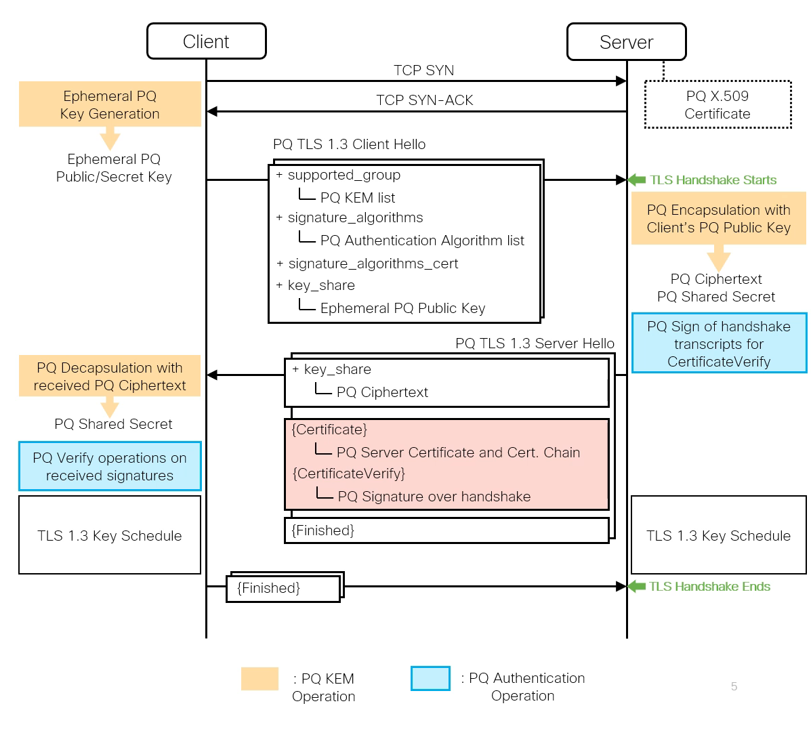
TLS with POST Quantum
Kyber
Dilithium
24
Notes:
As for the sequence diagram, TLS start with creating a TCP connection, than a client hello is sent from the client answered by a server hello messages, inside those messages we will integrate a quantum mechanism.

Slide 25
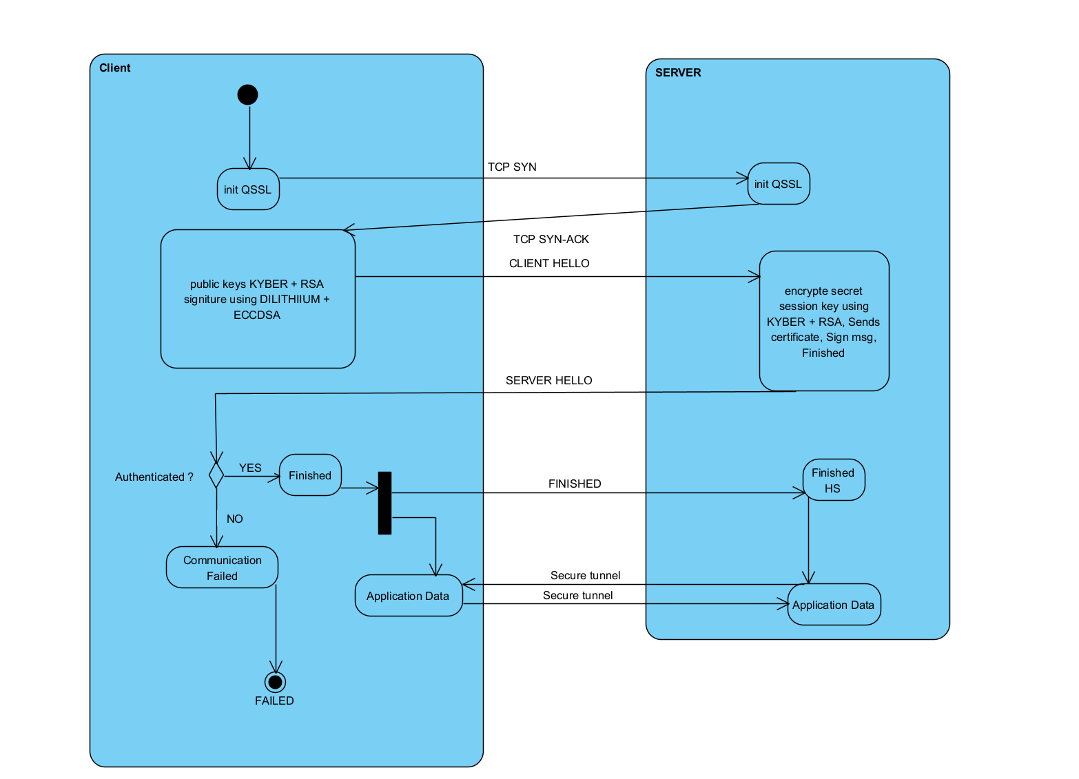
TLS with POST Quantum
25
Notes:
After creating the TCP the client will declare the algorithem it uses, the server will that replay with the sercret key encrypted with the hybrid mechanism. If all the steps went successfully the connection assumed to be secured to quantum attack.

Slide 26

THANK YOU!
26

